Slide 1
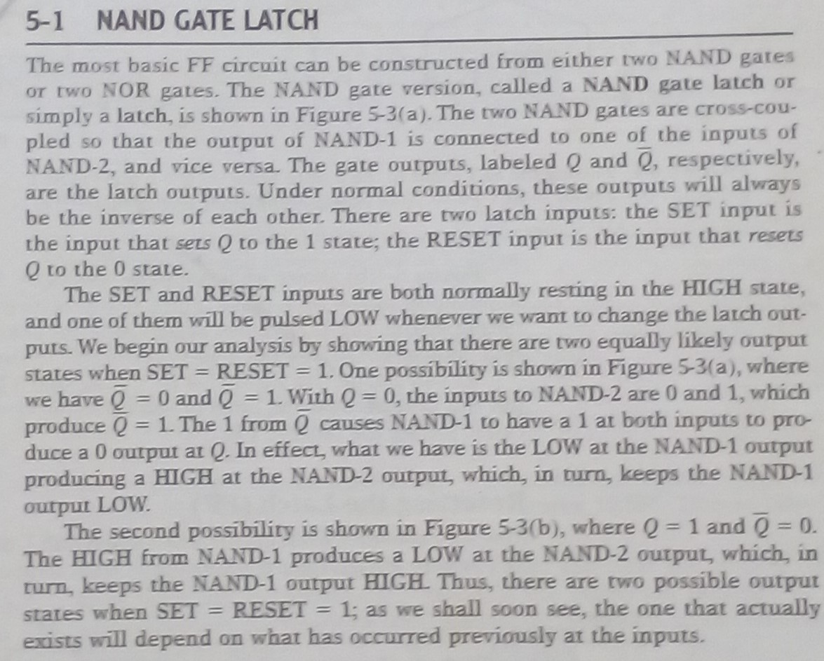
Lecture-14 Latch

Slide 2

NAND Latch

Slide 3

Setting

Slide 4
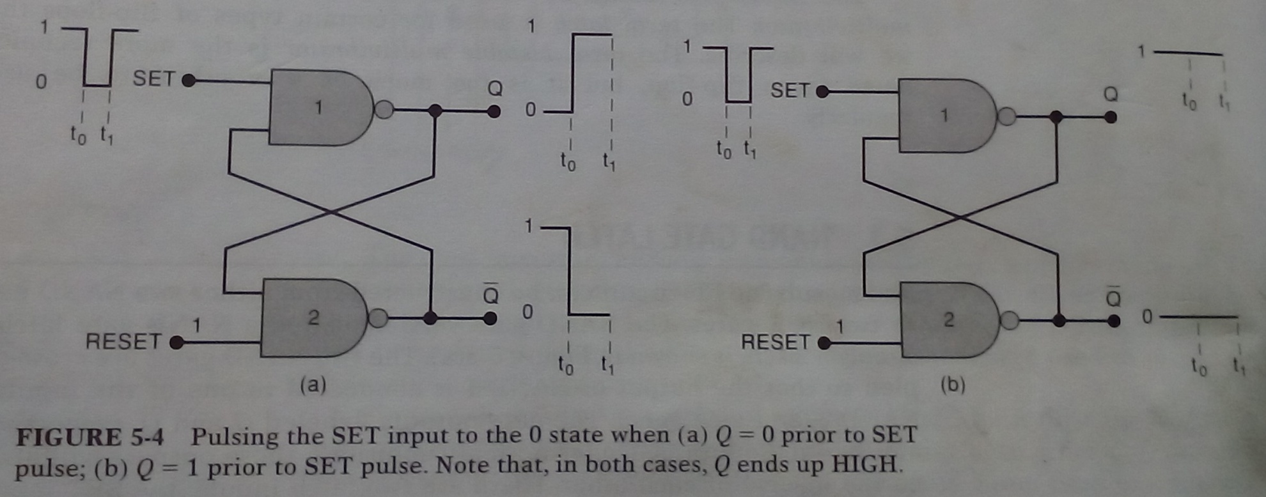
Setting

Slide 5

Setting

Slide 6
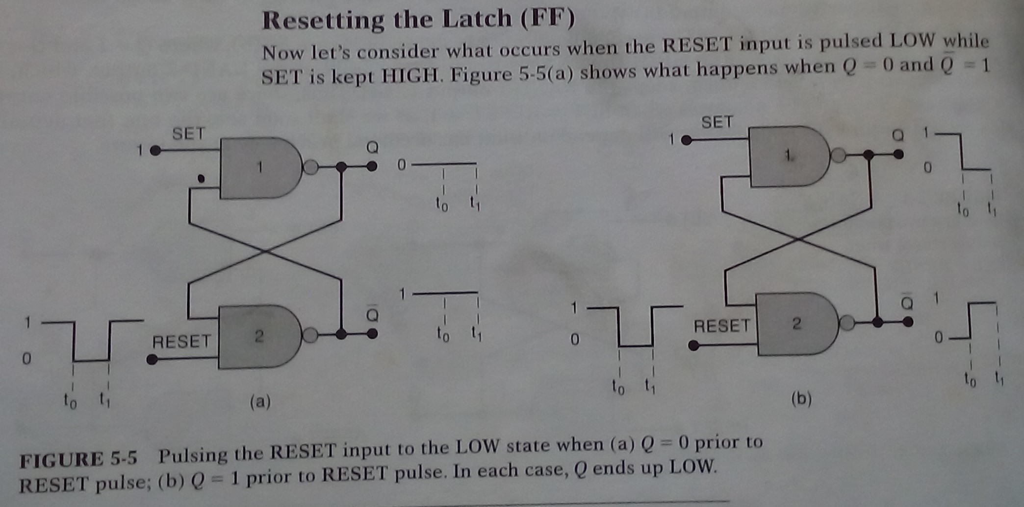
Resetting

Slide 7
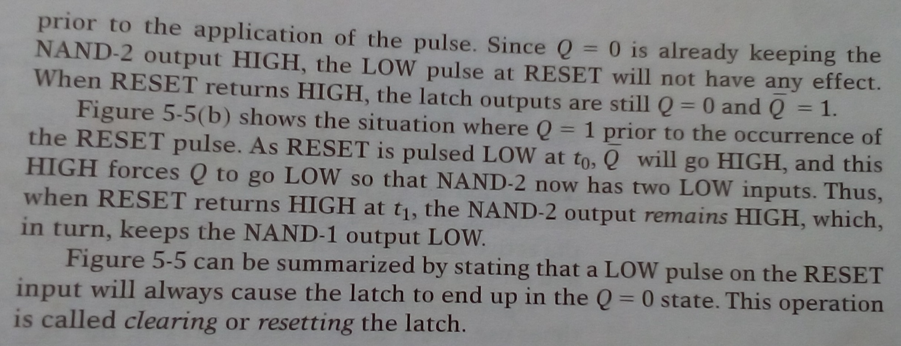
Resetting

Slide 8
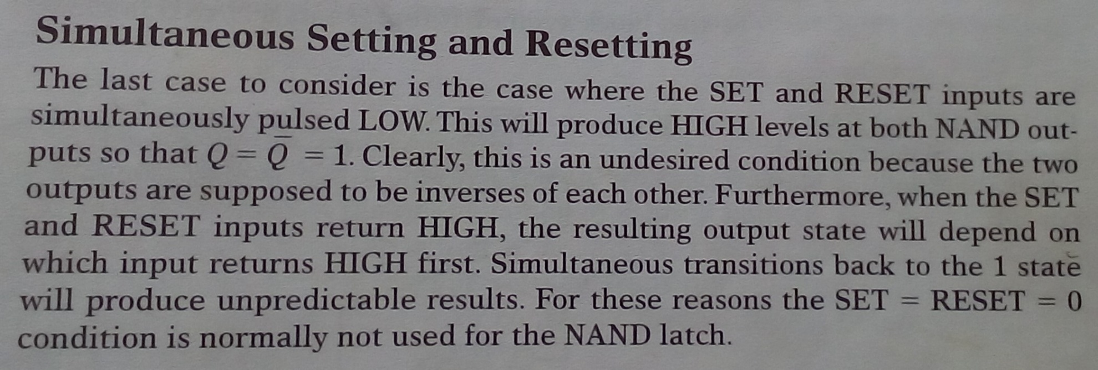
Setting & Resetting

Slide 9
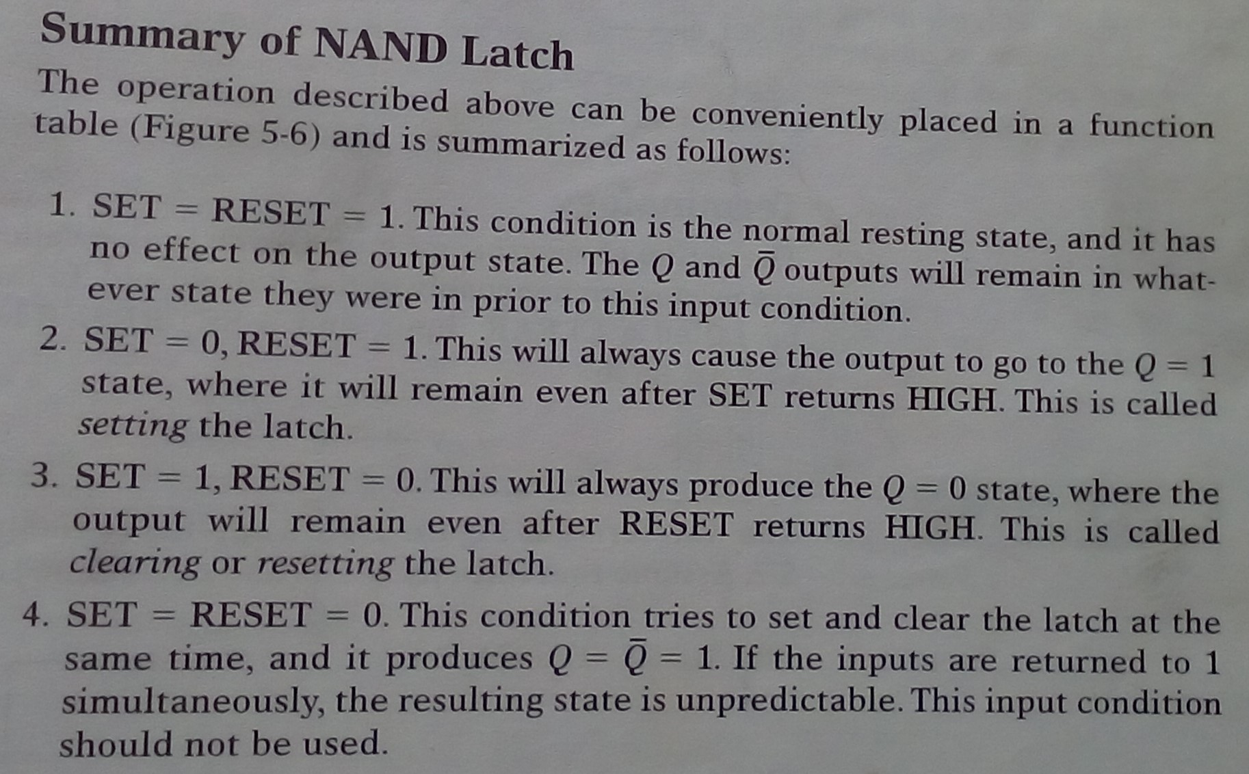
NAND Latch

Slide 10
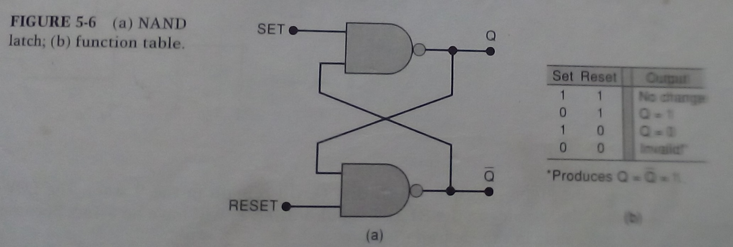
NAND Latch

Slide 11
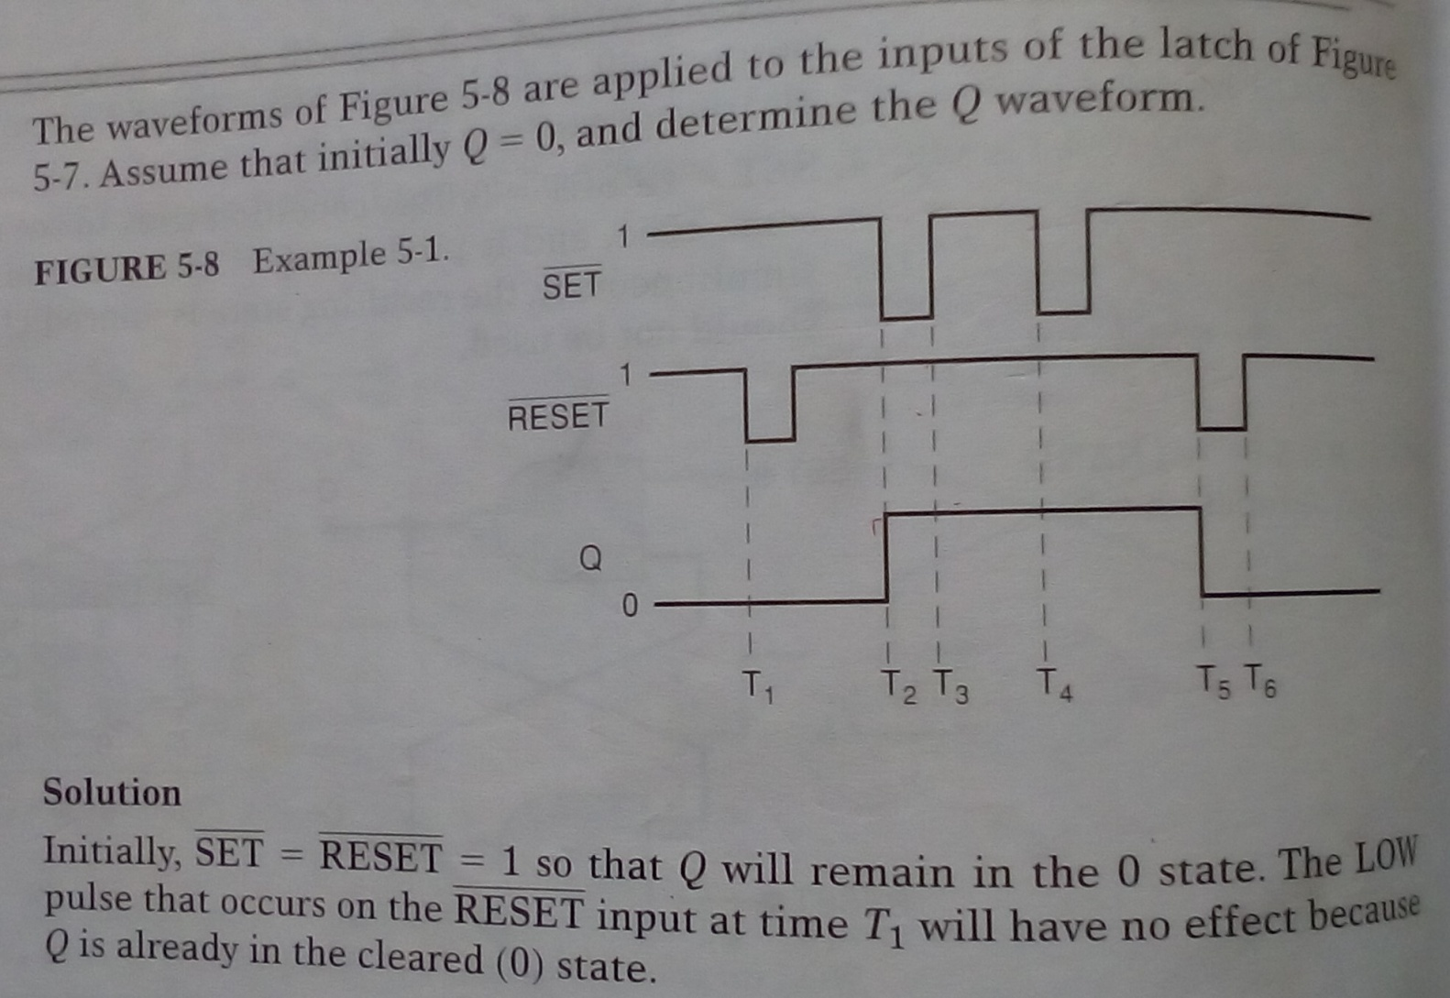
NAND Latch

Slide 12

NAND Latch

